Slide 1
AI ENGINEERING FRIDAYS · THE FAMILIAR FLOW
The familiar Claude Code loop
PLAN MODE
Read + propose
REVIEW
Refine + approve
EXECUTE
Edit + run
VERIFY
Review the result
→
→
→
A strong workflow for bounded work inside one session
AI Engineering Fridays · 1
Notes:
Open with the audience’s normal experience: “You are probably all very familiar with this flow.” In Plan Mode Claude reads and explores without editing source files, presents a plan, and begins editing after approval in the selected permission mode. Say plainly that this is a useful workflow and is not the problem.
Transition: “But what happens when the work is too large for one sitting, starts spawning new work, or needs to move across several sessions?”
[Sources]
- https://code.claude.com/docs/en/permission-modes
- Visual template: Agentic AI workflows — adoption stages + workflow descriptions.pptx
[/Sources]

Slide 2
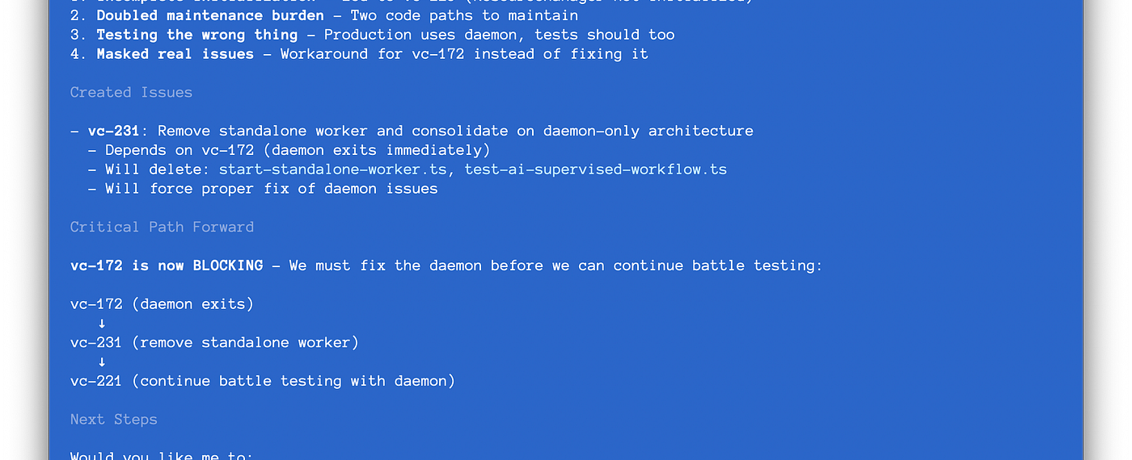
STEVE YEGGE · INTRODUCING BEADS · 2025
605 markdown plan files
“in varying stages of decay” — Steve Yegge
AI Engineering Fridays · 2
Notes:
Now show what “more complex” can become. Steve Yegge did not reject Markdown from the outset: he went all-in on Git-versioned, hierarchical Markdown plans for agent orchestration—and eventually found 605 plan files in varying stages of decay.
Use the screenshot as evidence: the agent has created a follow-up issue, recorded what it depends on, and made the critical path explicit. This is the move from plans as documents to work as queryable state.
Transition: “This pressure grows as we move from an assistant inside one session toward agents working across tasks and in parallel. You may remember this model from the sprint review.”
Accuracy note: the launch essay describes Beads’ historical JSONL implementation. Current technical claims later in the deck use the modern Dolt-based documentation.
[Sources]
- Steve Yegge, Introducing Beads: A coding agent memory system, 13 October 2025: https://steve-yegge.medium.com/introducing-beads-a-coding-agent-memory-system-637d7d92514a
- Original image from the essay: https://miro.medium.com/v2/resize:fit:1400/1*HbBoe7lEio9gX6v6-ZFbZQ.png
- Visual template: Agentic AI workflows — adoption stages + workflow descriptions.pptx
[/Sources]

Slide 3
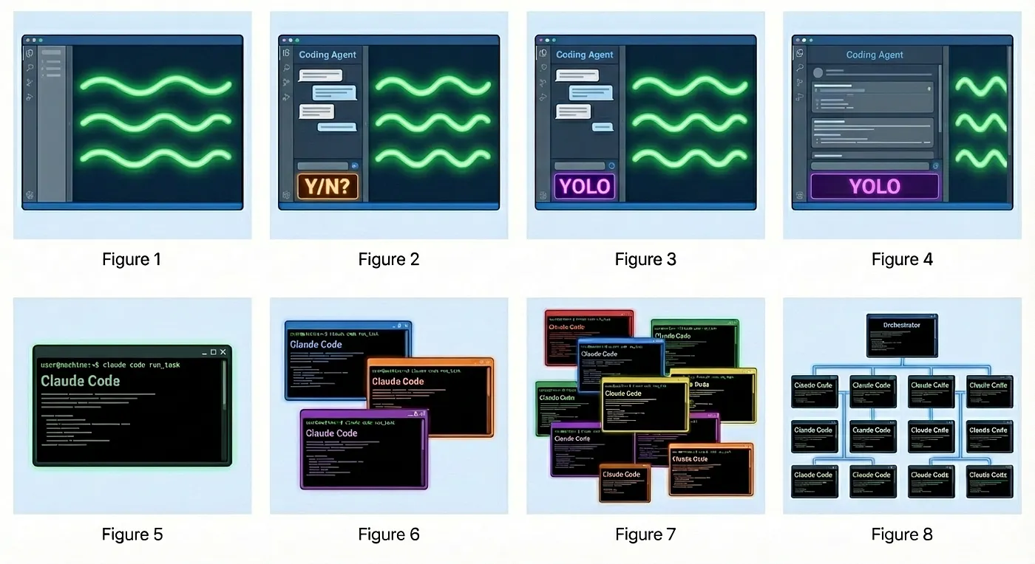
AI CODING WORKFLOW SNAPSHOT · ADOPTION MODEL
The Stages of AI Adoption
AI Engineering Fridays · 3
Notes:
This is the exact adoption-stages slide from the sprint review. Move quickly from left to right: interactive coding assistance, a more autonomous agent, task-bounded agents, then parallel orchestration. Treat it as a useful progression, not a maturity score everyone must climb.
The point for today is narrower: the farther right we work, the more tasks outlive an individual conversation and the more coordination state matters. A native Markdown plan can be enough on the left; durable, queryable task state becomes increasingly valuable as work becomes longer-lived and more concurrent.
Transition: “Even before full orchestration, ordinary engineering work already creates these pressure points.”
[Sources]
- Reused source slide: /Users/paishe01/hNotes/20__Output/Agentic AI workflows — adoption stages.pptx, slide 1
- User-provided asset: yegge-agent-evolution.webp
- Stage model reference: https://justin.abrah.ms/blog/2026-01-08-yegge-s-developer-agent-evolution-model.html
- Brand treatment: https://brandhub.stepstone.com/
[/Sources]

Slide 4
AI ENGINEERING FRIDAYS · THE PRESSURE POINTS
Real work escapes the session
Markdown can carry this—but each pressure adds another convention.
WHAT HAPPENS?
THE PLAN NOW NEEDS
Several sessions
→
State
Work continues tomorrow
New work appears
→
Provenance
Execution reveals a bug
Dependencies
→
A graph
Task B waits for Task A
A hand-off
→
Memory
Another session takes over
IDs · status · ownership · dependencies · provenance · hand-off context
AI Engineering Fridays · 4
Notes:
Let the complexity emerge through questions: What is done? What is next? Where does the bug belong? What is blocked? How does a fresh session know why? Acknowledge that Markdown can encode all of this. The point is that we are progressively designing task-management conventions inside the document.
Connect back to the adoption slide: parallelism is only the most visible version of the problem; continuity, provenance, and dependency tracking begin to matter as soon as work crosses a session boundary.
[Sources]
- Visual template: Agentic AI workflows — adoption stages + workflow descriptions.pptx
[/Sources]

Slide 5
AI ENGINEERING FRIDAYS · BEADS
Beads makes the work state explicit
bd prime
restore context
bd ready
find work
bd show
inspect
bd update
claim + record
bd close
hand off
→
→
→
→
Discovered work becomes a linked bead—not a lost note
AI Engineering Fridays · 5
Notes:
Introduce beads only now. It is a persistent, dependency-aware task graph designed for AI-supervised coding workflows. The agent can restore project context, find unblocked work, inspect one bounded unit, claim it, record discovered work with provenance, and leave a durable hand-off.
[Sources]
- https://github.com/gastownhall/beads/blob/main/docs/index.md
- https://github.com/gastownhall/beads/blob/main/docs/getting-started/ide-setup.md
- https://github.com/gastownhall/beads/blob/main/docs/multi-agent/coordination.md
- Visual template: Agentic AI workflows — adoption stages + workflow descriptions.pptx
[/Sources]

Slide 6
AI ENGINEERING FRIDAYS · LIVE DEMO
A short beads loop
A fresh session can recover context and leave the next one a clean hand-off.
COMMAND
RESULT
bd prime
1
Orient
Load workflow + project memory
bd ready
2
Choose
Find work with no open blockers
bd show <id>
3
Understand
Inspect one bounded task
update · create · close
4
Continue
Act, record discoveries, hand off
The task graph survives even when the conversation does not.
AI Engineering Fridays · 6
Notes:
Switch to the terminal. Run the prepared demo from presentation/demo-runbook.md. Keep this to roughly three minutes. If the live agent response stalls, use the deterministic CLI path and continue; the audience still sees the same persisted context and task graph.
[Sources]
- https://github.com/gastownhall/beads/blob/main/docs/index.md
- Local demo runbook: presentation/demo-runbook.md
- Visual template: Agentic AI workflows — adoption stages + workflow descriptions.pptx
[/Sources]

Slide 7
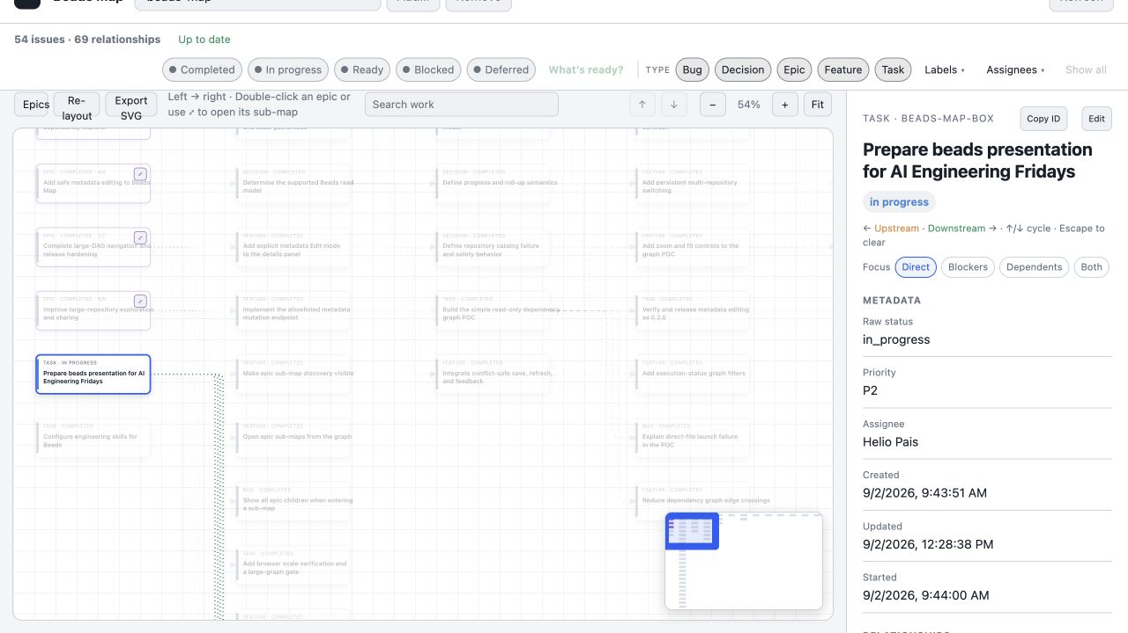
AI ENGINEERING FRIDAYS · BEADS MAP
Beads Map makes the hand-off visible
AI Engineering Fridays · 7
Notes:
Show the presentation task selected with its children, state, description, acceptance criteria, design, and notes. The opening slide already established the repository-level view; here, zoom into one durable hand-off.
[Sources]
- Local screenshot captured from beads-map on 2026-09-02: presentation/assets/beads-map-presentation-work.png
- Visual template: Agentic AI workflows — adoption stages + workflow descriptions.pptx
[/Sources]

Slide 8
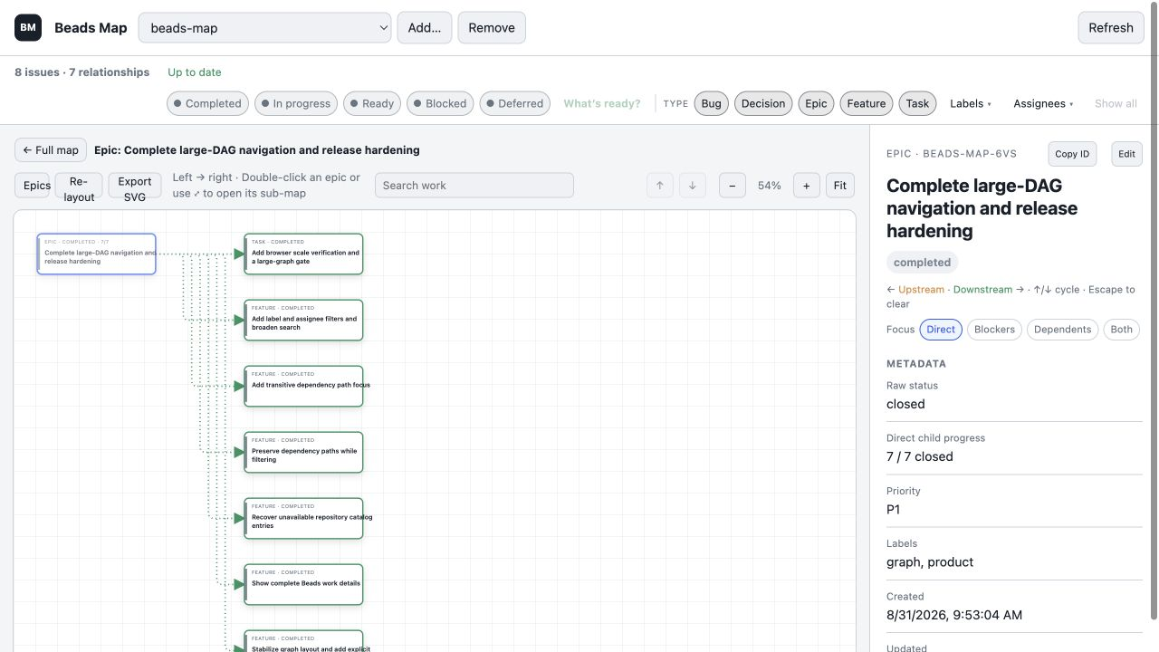
AI ENGINEERING FRIDAYS · PROOF
49 completed beads in seven days
AI Engineering Fridays · 8
Notes:
This is not a benchmark or a causal productivity claim. It is a traceable project history: 49 beads were closed between 25 and 31 August 2026, spanning product decisions, implementation, bugs, packaging, and release hardening. The visualizer shown here was built through the system it visualizes.
Transition: “That naturally raises a team question: can several people and agents share this graph, or is Beads mainly a solo workflow?”
[Sources]
- Local bd stats and closed-issue records inspected 2026-09-02
- Local screenshot captured from beads-map on 2026-09-02: presentation/assets/beads-map-release-hardening.png
- Visual template: Agentic AI workflows — adoption stages + workflow descriptions.pptx
[/Sources]

Slide 9
AI ENGINEERING FRIDAYS · TEAM REPOSITORIES
Yes—with a Git-like collaboration model
Developer /
agent A
local
Dolt DB
Git remote
refs/dolt/data
local
Dolt DB
Developer /
agent B
↔
↔
↔
↔
Shared graph, explicit sync: pull · claim · push—not automatic live updates
AI Engineering Fridays · 9
Notes:
Short answer: yes—with a collaboration model closer to Git than Jira. Each collaborator or agent works against a local Dolt database. Beads history is shared through bd dolt pull and bd dolt push under refs/dolt/data on the remote, separate from normal code branches.
The collaboration support is substantive: hash-based IDs reduce creation collisions, Dolt merges changes at cell level, and Beads documents assignments, comments, atomic claims, hand-offs, fan-out/fan-in, and merge slots.
Keep the qualification explicit. This is distributed, eventually synchronized state—not automatic live sync. A fresh clone needs bd bootstrap; a colleague sees pushed work after pulling. Atomic claim is strongest when agents use the same current database or ready queue; disconnected clones can both act on stale state until they synchronize. If several processes write to the same database on one machine, use Dolt server mode rather than the default single-writer embedded mode.
For an enterprise-hosted Git service, test support for the refs/dolt/data transport before promising frictionless adoption. The official docs describe Git-protocol remotes but do not publish a provider compatibility matrix.
[Sources]
- https://github.com/gastownhall/beads/blob/main/docs/core-concepts/sync-concepts.md
- https://github.com/gastownhall/beads/blob/main/docs/reference/faq.md
- https://github.com/gastownhall/beads/blob/main/docs/multi-agent/coordination.md
- https://github.com/gastownhall/beads/blob/main/docs/architecture/dolt.md
[/Sources]

Slide 10
AI ENGINEERING FRIDAYS · YOUR TURN
Try it—and let me know
Start with one real task that will still matter tomorrow.
FIRST EXPERIMENT
OUTCOME
Install
1
Once
brew install beads
Initialize
2
Scope
bd init inside one repository
Resume
3
Context
bd prime in a fresh session
Tell me
↗
Feedback
What worked? What got in the way?
Use beads where the work—not merely the chat—needs continuity.
AI Engineering Fridays · 10
Notes:
Close after the collaboration qualification, without overselling. Ask people to try beads on one genuine multi-session task—solo or in a small team—and tell you where the pull, claim, and push discipline helps or adds friction. Leave the final slide visible for questions.
[Sources]
- https://github.com/gastownhall/beads/blob/main/docs/index.md
- Visual template: Agentic AI workflows — adoption stages + workflow descriptions.pptx
[/Sources]

